Slide 1

FINAL YEAR PROJECT PROPOSAL
HAND GESTURE
RECOGNITION FOR HOME
APPLIANCES CONTROL
BY
ONYENEKE ANTHONY CHIDUBEM
MATRIC NUMBER:
200353
DEPARTMENT:
ELECTRICAL & ELECTRONIC ENGINEERING
SUPERVISOR:
DR. OLUYEMI E. ADETOYI

Slide 2
PRESENTATION OUTLINE
Introduction
Problem Statement
Aim
Objectives
Literature Review
Methodology
Result
Project Cost
Recommendation
Conclusion

Slide 3
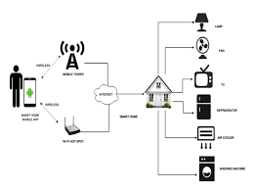
INTRODUCTION
Convolutional neural network (CNN) is a type of feed-forward neural network designed for processing structured arrays of data such as images.
Applications: image analysis & classification, natural language processing etc.
Home automation is the automatic control of electronic devices in homes.
An Automated Home

Slide 4
PROBLEM STATEMENT
Accurately recognizing hand gestures can be a challenging task due to:
Variations in hand shape
Variations in orientation
Movement
Presence of noise and background distractions in the visual input

Slide 5
AIM
Implementation of a convolutional neural network (CNN) model on a low power IOT device that accurately recognizes and classifies various hand gestures in real time, which can be used to control home devices.

Slide 6
OBJECTIVES
To develop a system that accurately detects and classifies hand gestures.
To develop a system that controls devices using hand gestures.
To design a user-friendly interface for the hand gesture recognition system.
Optimizing the use of CNN for hand gesture recognition in terms of computational efficiency and power consumption, with the goal of making the system suitable for deployment on low-power IoT devices.

Slide 7
LITERATURE REVIEW
(Stergiopoulou, 2009) developed the use of artificial neural network (ANN) in hand gesture recognition. For this system, a color segmentation approach was applied in hand detection after filtering. Extracted features were then passed on to the ANN (94.05%).
(N. D. Georganas, 2008) proposed the use of haar-like features in gesture detection. Adaboost was the algorithm used to learn the model (71.48%).
(H. Huynh, 2013) also went on to develop gesture detection using the ANN. Skin colors were the focal point in the segmentation of images for this system. ANN’s selected features were variation of pixels through scalar description, boundary and cross sections . Feature vectors were used in training (98%).

Slide 8
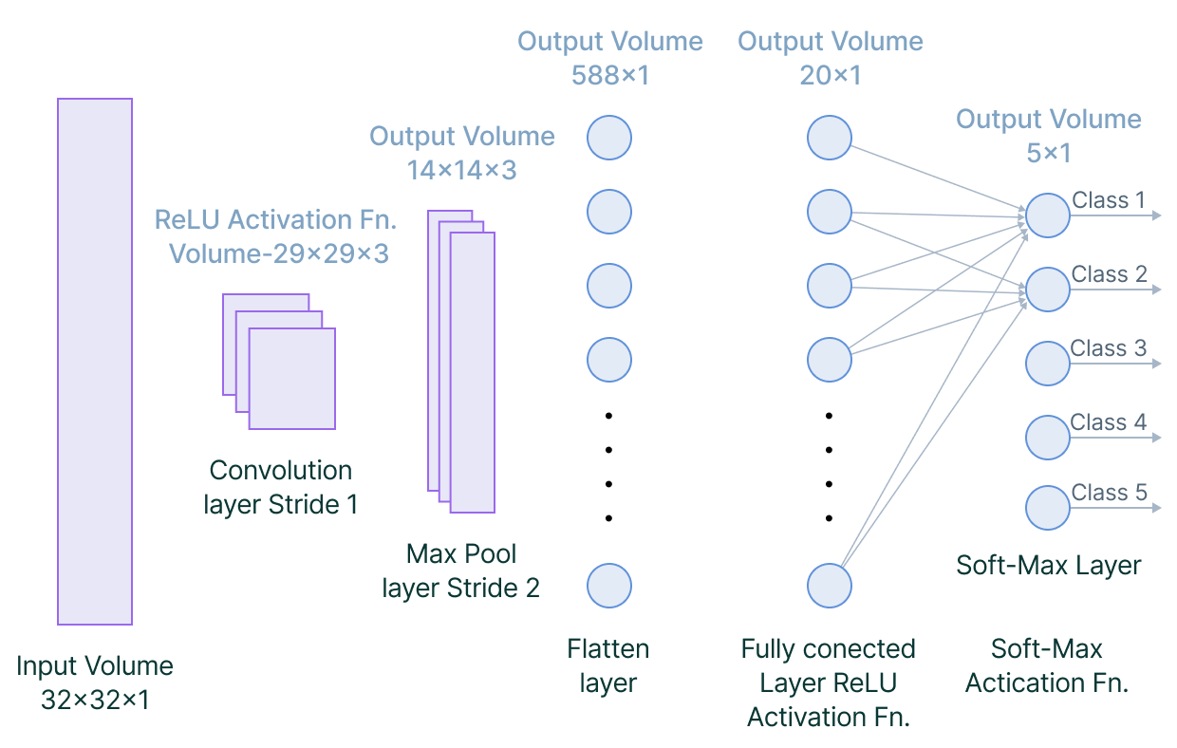
LITERATURE REVIEW
(S. Gupta, 2015) proposed an algorithm that uses a 3D CNN for hand gesture recognition. Image intensity and challenging depth were the basis of recognition for this system. (VIVA dataset, 77.5%).
(G. Cutipa, 2017) also proposed the use of CNN in gesture recognition using the five invariants scale: noise, translation, background, illumination and rotation (LSP dataset, 96.2%).

Slide 9
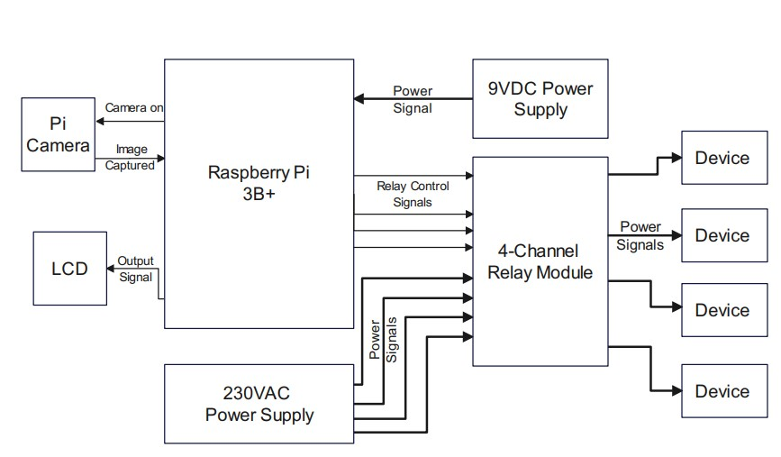
methodology
Block diagram of the project

Slide 10
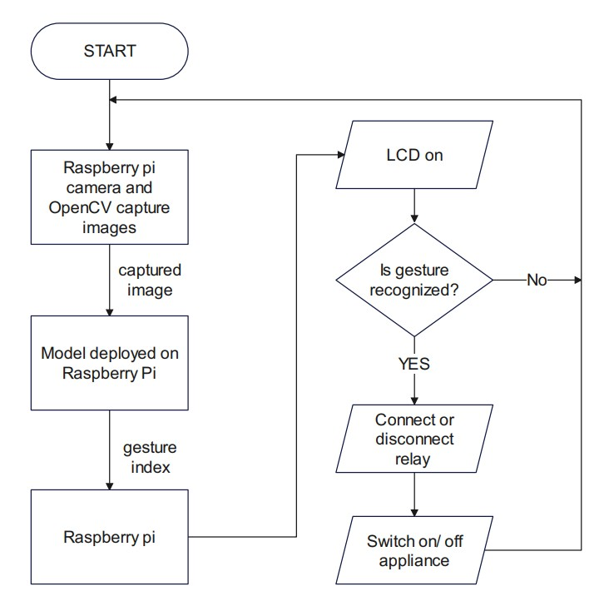
methodology
Flowchart of the project

Slide 11
methodology
BUILDING THE MODEL
Python (Spyder IDE) was used for training the model. The following libraries were used:
Keras – Creation of the CNN classifier
Sklearn – Confusion matrix calculation
OpenCV – Image processing
Numpy – Array operations
Matplotlib – Visualization of confusion matrix, model accuracy and loss values and classification report (precision, recall and f1-score)
Model was trained on a laptop before it was deployed on the raspberry pi.

Slide 12
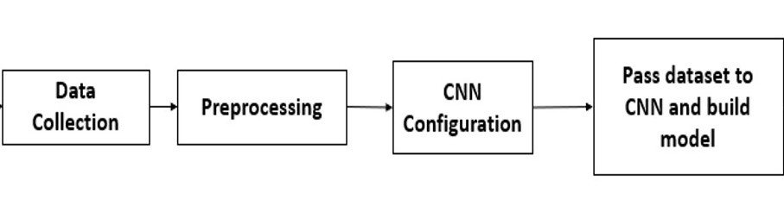
methodology
IMAGE PROCESSING TRAINING PROCEDURES
Collection of Data
Pre-processing of Data
Configuration of the CNN
Training the CNN and building of the model
Image Processing Training Procedures

Slide 13
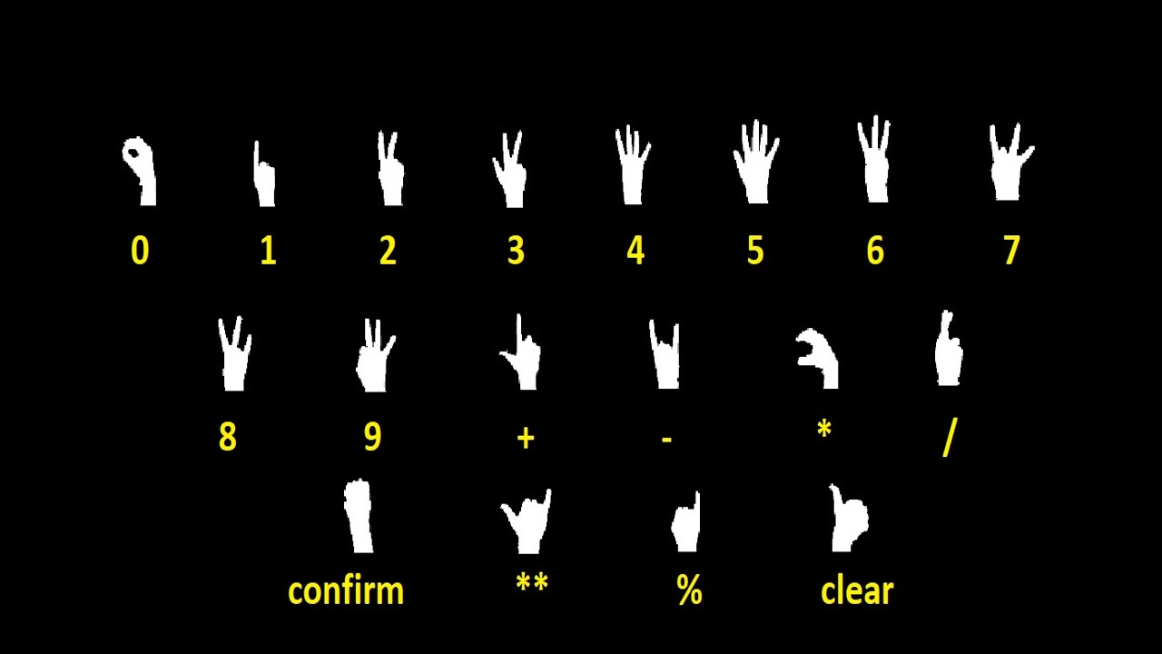
methodology
DATA COLLECTION AND PRE-PROCESSING
This project will make use of the Kaggle hand gesture dataset.
FEATURES
21780 images
18 different hand gestures (1210 each)
900 training images
310 testing images
Images are already pre-processed
Kaggle Hand Gesture Dataset

Slide 14
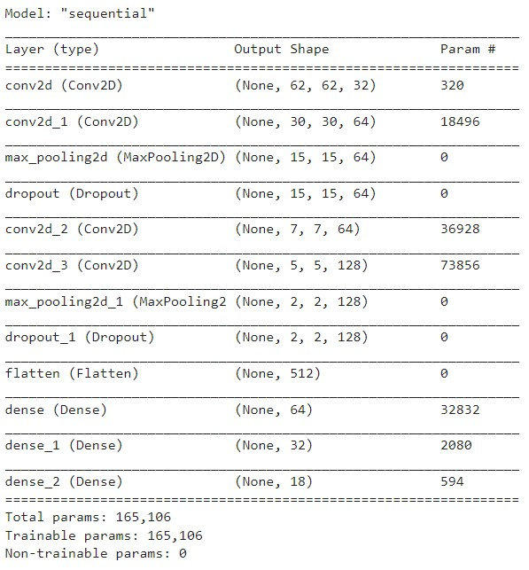
methodology
Summary of Model Architecture

Slide 15
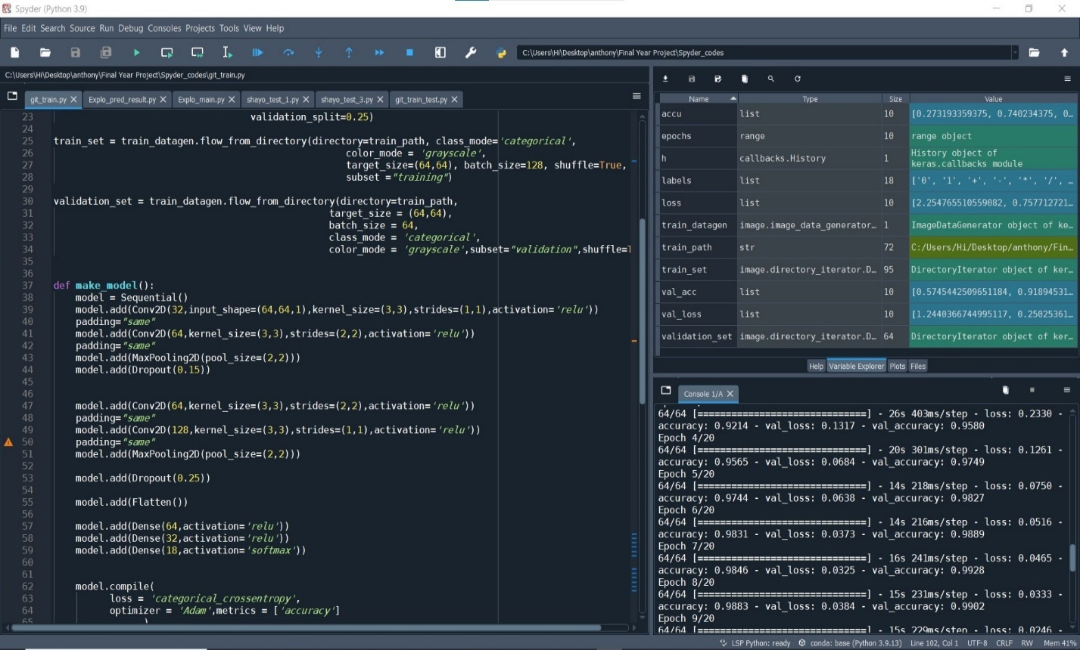
methodology
Training of model after CNN Configuration

Slide 16
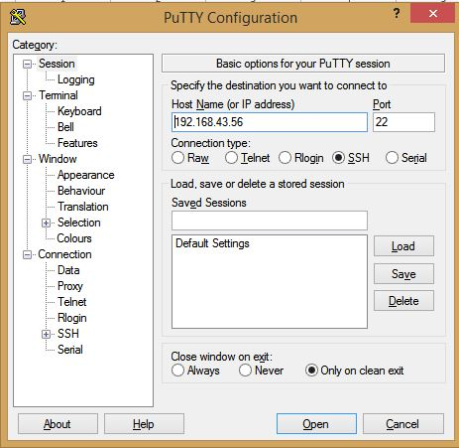
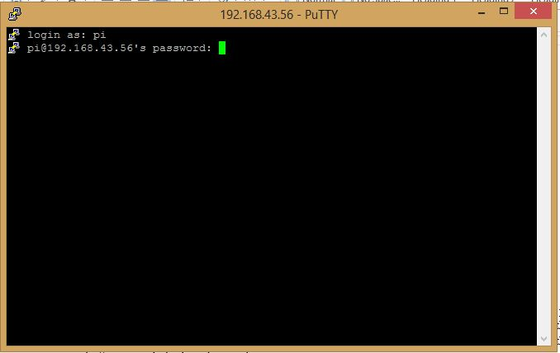
METHODOLOGY
Raspberry Pi Configuration using Putty

Slide 17
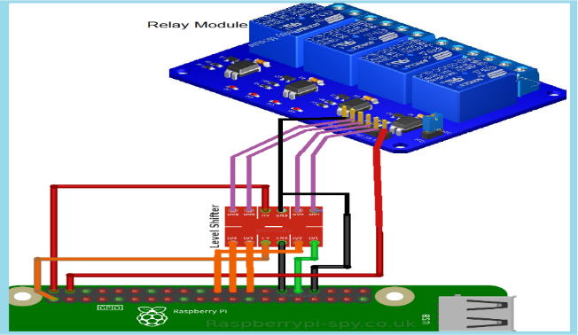
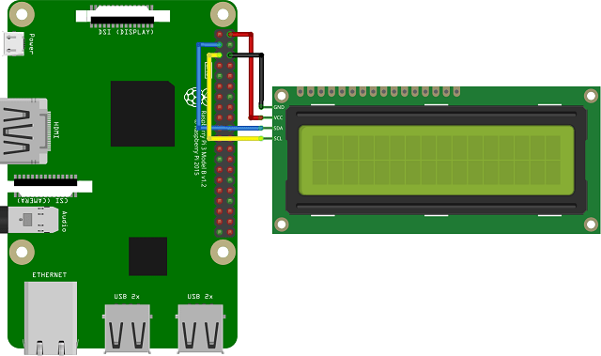
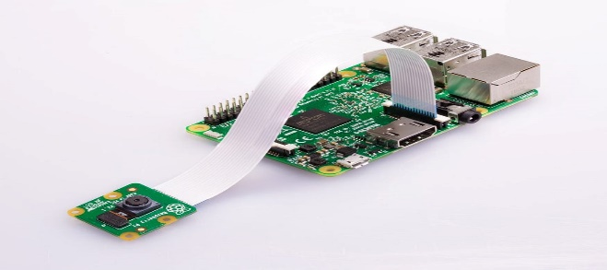
METHODOLOGY
System construction

Slide 18
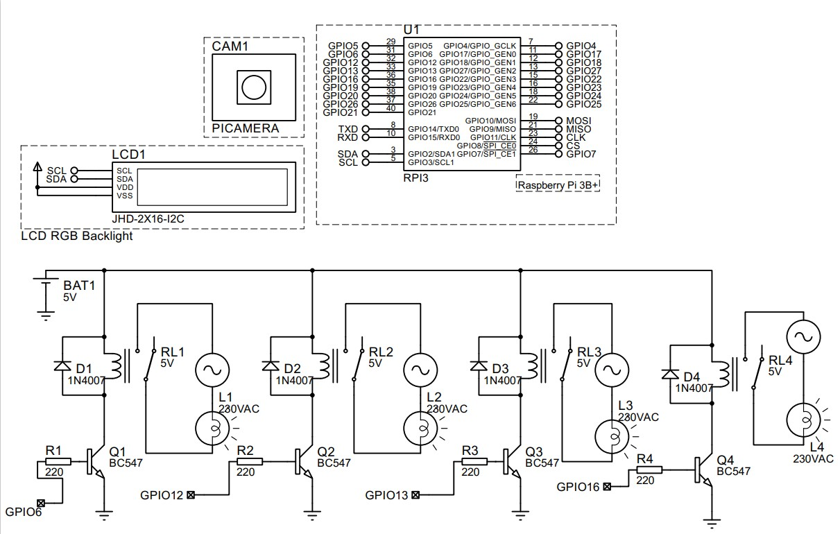
METHODOLOGY
Raspberry Pi Configuration using Putty

Slide 19
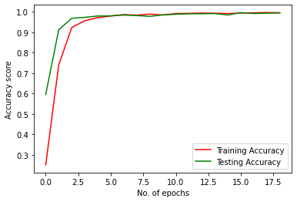
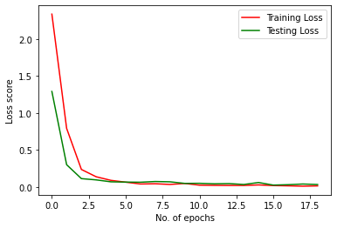
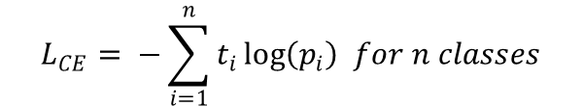

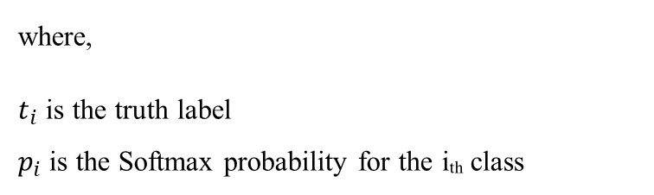
RESULTs
Accuracy
Loss
$$A=\frac{No. of Correct Predictions}{Total no. of Predictions}$$
$$L_{CE}= −\sum_{i=1}^{n}{t_{i}\log\left(p_{i}\right) for n classes}$$
where,
$t_{i}$ is the truth label
$p_{i}$ is the Softmax probability for the iₜₕ class

Slide 20
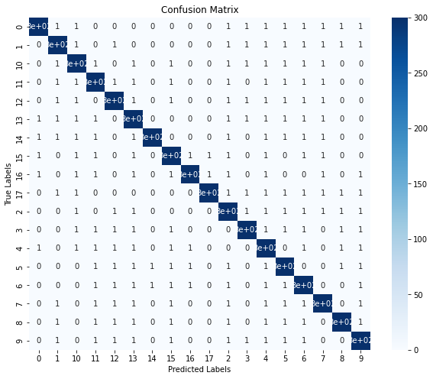
RESULTs
Confusion Matrix

Slide 21
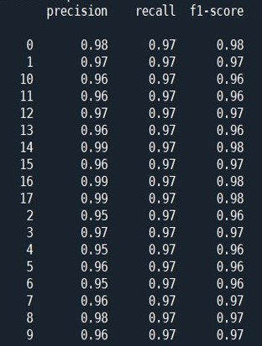
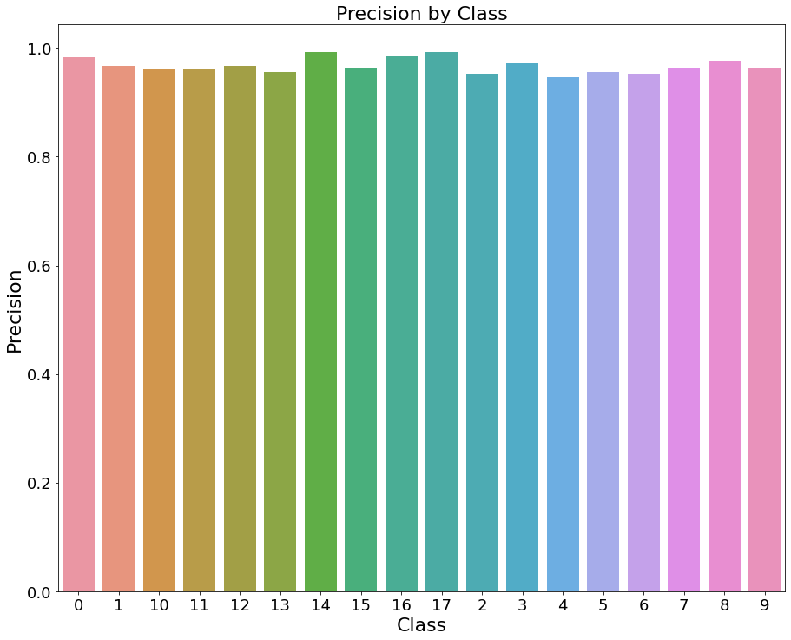
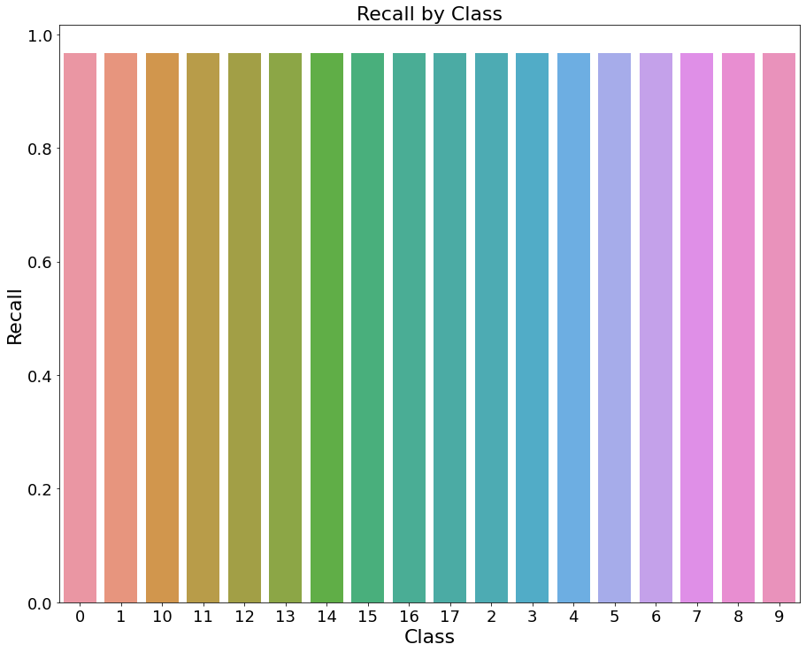
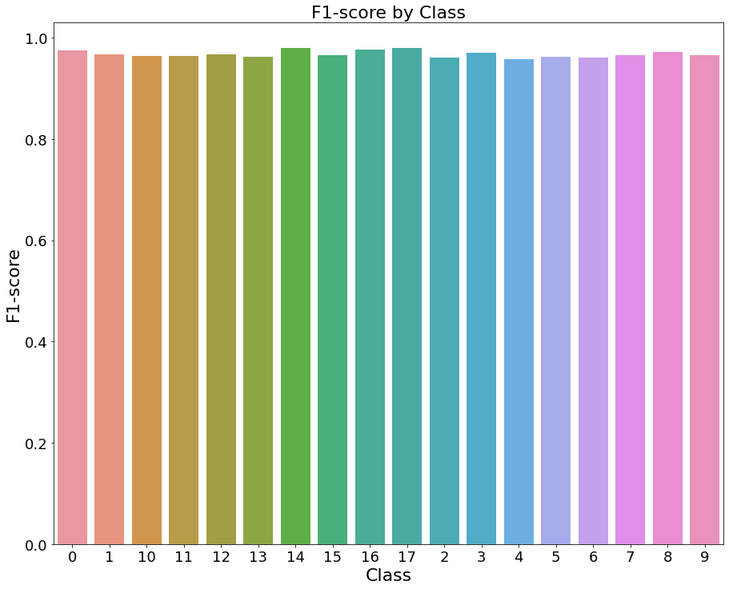
RESULTs
Classification Report
Precision
Recall
F1-score

Slide 22
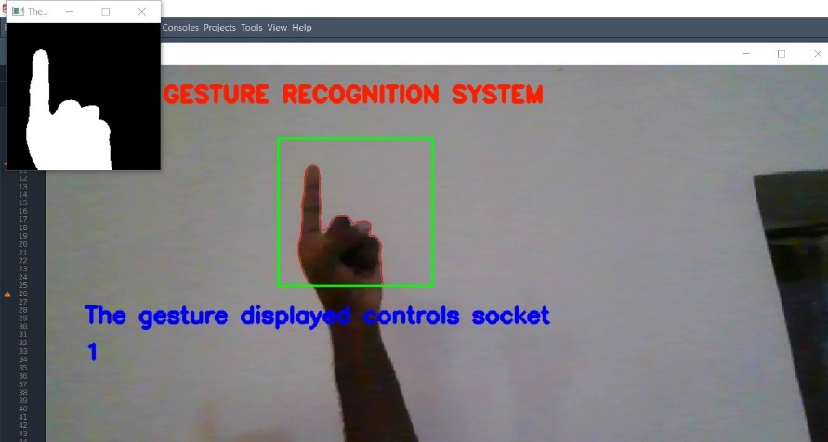
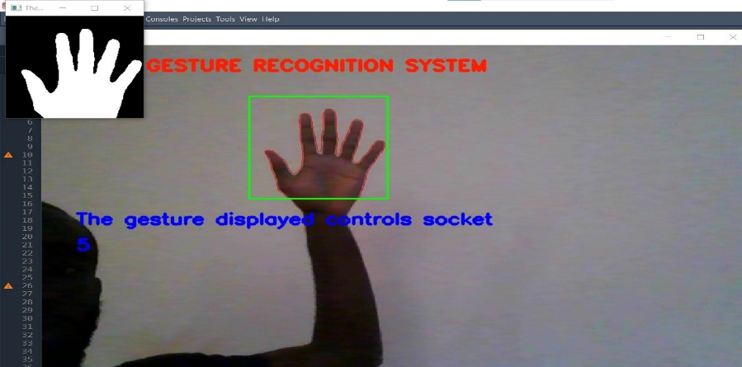
RESULTs
System recognizing hand gestures ‘1’ and ‘5’

Slide 23
Project cost
S/N | COMPONENT | QUANTITY | COST (NAIRA)
1. | I2C Liquid Crystal Display (LCD) | 1 | 2000
2. | Raspberry Pi 3B | 1 | 102,930
3. | Dupont jumper wires | 1 pack | 3,500
4. | Soldering Lead | 1 | 1000
5. | Bi- directional Level Converter | 1 | 900
6. | Enclosure | 1 | 800
7. | 13A Flat MGC Socket | 4 | 6000
8. | 13A Plug | 4 | 2000
9. | 4-Channel Relay Module | 1 | 9000
10. | Raspberry Pi CSI Camera | 1 | 4500
Total Project Cost Estimate = 132,630 naira

Slide 24
Recommendations
development of models that require lesser RAM so as to reduce the cost of deployment or application.
identification of complicated hand gestures involving motion and two hands.
development of a system that can detect gestures in the dark and also perform more complex background subtractions as image processing would fail if background is very similar to skin color and if there is poor lightning.

Slide 25
CONCLUSION
The hand gesture recognition system was:
highly accurate, fast and robust to variations in hand gestures and background noise.
user-friendly, with a simple and intuitive interface.
efficient and lightweight, with an algorithm that was designed to run on low-power IoT devices.
successfully used for control of home appliances.

Slide 26
REFERENCES
G. Cutipa, R. L. (2017). Application of convolutional neural networks for static hand gestures recognition under different invariant features. Electrical Engineering and Computing (INTERCON), pp. 1–4.
H. Huynh, J. M.-N. (2013). Static hand gesture recognition using artificial neural network. Journal of Image and Graphics, vol. 1, no. 1, pp. 34–38.
N. D. Georganas, E. M. (2008). Hand gesture recognition using haar-like features and a stochastic context-free grammar. IEEE transactions on instrumentation and measurement, vol. 57, no. 8, pp. 1562–1571.
S. Gupta, P. M. (2015). Hand gesture recognition with 3d convolutional neural networks. Proceedings of the IEEE conference on computer vision and pattern recognition workshops, pp 1-7.
Stergiopoulou, N. P. (2009). Hand gesture recognition using a neural network shape fitting technique. Engineering Applications of Artificial Intelligence, vol. 22, no. 8, pp. 1141–1158.

Slide 27
THANK YOU !

